Slide 1
iPRG 2013:
Using RNA-Seq data for Peptide and Protein Identification
ABRF 2013, Palm Springs, CA
3/02-05/2013

Slide 2
iPRG2013 Study:
DESIGN

Slide 3
Study Goals
Primary: Evaluate how many extra peptide sequence identifications can be determined using databases derived from RNA-Seq data
Secondary: Compare number of extra identifications due to single nucleotide variants vs. novel sequences
Tertiary: Evaluate whether restricted size protein database based on RNA-Seq data is advantageous

Slide 4
Study Design
Use a dataset with matched RNA-Seq and tandem mass spectrometry data
By comparing RNA-Seq data to reference genome sequence create two extra databases
  Sequences corresponding to SNV in comparison to reference genome sequence
  Novel sequences that do not match to reference genome allowing for a SNV.
Allow participants to use the bioinformatic tools and methods of their choosing
Use a common reporting template
Report results at an estimated 1% FDR (at the peptide level)
Ignore protein inference

Slide 5
Study Data
Sample:
Whole cell lysate of human peripheral blood mononuclear cells
Data from Chen et al. Cell 2012 148(6):1293-1307
RNA analyzed via RNA-Seq workflow on Illumina GA2
Corresponding protein sample was digested with trypsin
Labeled with isobaric TMT6Plex tags
Fractionated into 14 fractions via high pH reversed-phase chromatography
Analyzed with 3 hr runs on a Thermo Orbitrap Velos with HCD
Both MS1 and MS2 acquired in the orbitrap
The iPRG also assessed two other datasets available to us, a mouse cell line and a human cell line, but initial analysis suggested these datasets contained fewer SNV and novel sequences, so were less suitable for the goals of the study.

Slide 6
Supplied Study Materials
14 LC-MS/MS files
  .RAW, mzML or MGF
  conversions by msconvert (ProteoWizard)
RNA-Seq
Four reference protein databases derived from RNA-Seq data
  These will described in following slides
Results template (Excel)
On-line survey (Survey Monkey)

Slide 7

MS/MS database search
Sequence Database
>SEQ1
CVVRELCPTPEGKDIGES
VDLLKLQWCWENGTLRSL
DCDVVSRDIGSESTEDRA
MEDIK
>SEQ2
DLRSWTVRIDALNHGVKP
HPPNVSVVDLTNRGDVEK
GKKIFVQKCAQCHTVEKG
GKHKT
Raw MS/MS spectra
Similarity score
0.89
0.34
0.29
Peptides of
indistinguishable
masses
Can only identify what is in the reference sequence database!

Slide 8
Typical MS/MS sequence databases
IPI (International Protein Index) is now deprecated
UniProtKB (canonical, CompleteProteome, varsplic, variants, TrEMBL)
Swiss-Prot (UP canonical + varsplic )
Ensembl
RefSeq
NCBInr
All a bit different, but generally interchangeable for well-annotated species such as human
Some take into account natural variants but are biased toward the reference genome

Slide 9
RNA-Seq assisted proteomics
Many/most organisms have a slightly different genome than the reference genome for their species
RNA-Seq analysis now has a low enough cost that it is justifiable to perform in addition to a multi-run MS/MS analysis
Leads to a new workflow where RNA-Seq data can assist the analysis of a corresponding proteomics sample

Slide 10
Benefits of RNA-Seq assisted proteomics
Using RNA abundance to reduce protein database size
  If all detectable proteins have detected RNA, then proteins with RNA abundance below a certain threshold can be discarded from the search database
RNA-Seq analysis can yield single amino acid variants specific to the sample
RNA-Seq analysis can yield additional sequences that are not mappable to the reference genome/proteome
  Benefit of this can be strongly variable based on the quality of the genome annotation as well as material from other species in the sample
RNA abundance can help with protein inference

Slide 11
Analysis pipeline for RNA-Seq data
Pipeline:
  sratoolkit fastq-dump to convert sra -> fastq format
  fastqc to examine the quality of the reads
  preprocessReads.pl to trim out bad ends
  Bowtie1 to align short reads to the Ensembl human genome
  Cufflinks to assemble transcripts and calculate abundances
  TopHat to identify SNVs (single nucleotide variants)
  snpEff_3_1 to create a peptide database from SNVs
  Kaviar to identify SNVs that are already known in KBs
  get_novel_transcript_dnaseq.pl to get novel transcripts
  DNA_SixFrames_Translation.py to create 6-frame translations
  Variations in the Bowtie1 step 4:
  Bowtie2 against RefSeq
  4. subread (C version) against Ensembl
Notes:
11

Slide 12
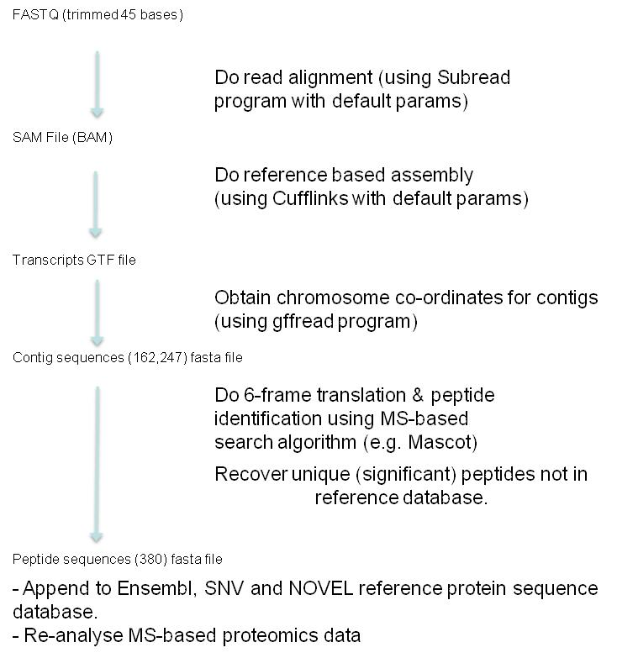
Analysis pipeline for RNA-Seq data
Workflow using
alternative mapping/
alignment program
(Subread)
Notes:
12

Slide 13
Resulting sequence databases
Ensembl GRCh37.68
Ensembl GRCh37.68 with exact protein sequence duplicates removed
Ensembl GRCh37.68 NR + cRAP potential contaminants
Ensembl GRCh37.68 NR + cRAP ← FPKM RNA abundances
( FPKM = fragments per kilobase of exon per million fragments mapped )
Ensembl GRCh37.68 NR + cRAP FPKMgt0
( only includes proteins derived from RNAs with abundance FPKM > 0 )
SNV: Peptide fragments surrounding detected SNVs
NOVEL: RNA sequences that cannot be mapped to the Ensembl genome
Ensembl GRCh37.68 NR + cRAP + SNV
( includes peptide fragments surrounding detected SNVs)
Ensembl GRCh37.68 NR + cRAP + NOVEL
( includes 6-frame translated protein fragments from novel RNA sequences )

Slide 14
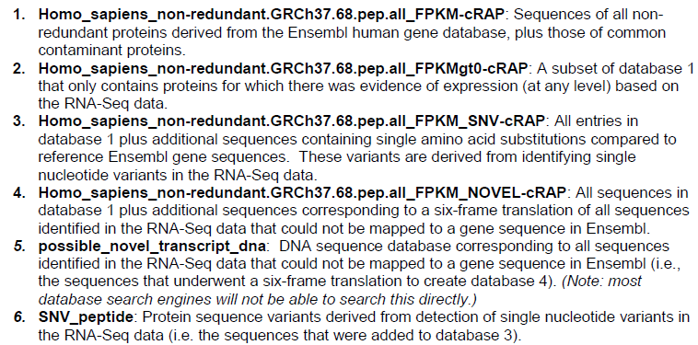
Provided Databases
Notes:
14

Slide 15
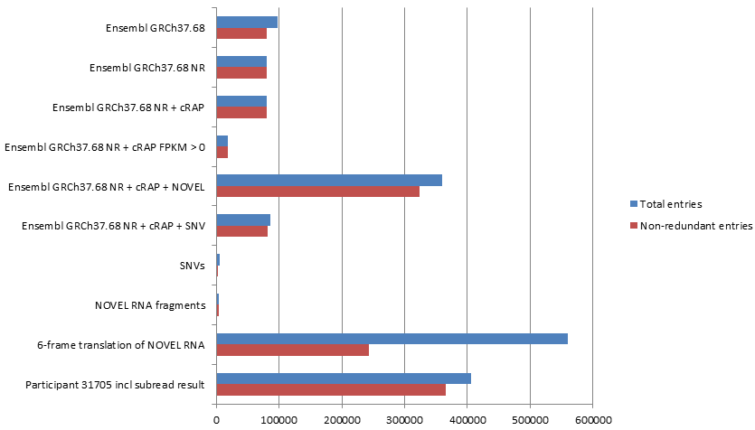
Comparison of Databases
Number of total entries
97,000
80,000
19,000
323,000
2,500
1,200 of these are listed in UniProtKB ! TrEMBL
4,000
243,000
366,000
Notes:
15

Slide 16
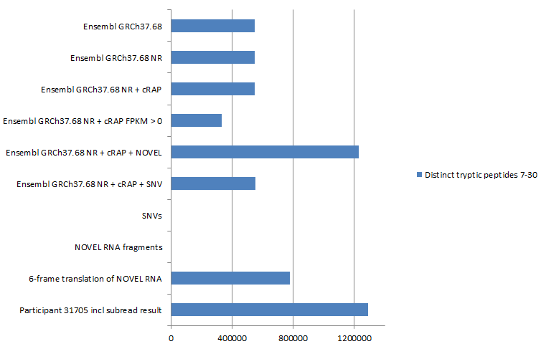
Comparison of Databases
Distinct tryptic peptides length 7-30
550,000
333,000
1,231,000
552,000
2,200
780,000
1,293,000
Notes:
16

Slide 17
Instructions to Participants
Retrieve and analyze the data file in the format of your choosing, with the method(s) of your choosing.
Search against the Ensembl reference database and compare results from other databases to those identified in reference database. Report the peptide to spectrum matches in the provided template.
Fill out the survey.
Attach a 1-2 page description of the methodology employed.

Slide 18
iPRG 2013 STUDY:
PARTICIPATION

Slide 19
Soliciting Participants and Logistics
Study advertised on the ABRF website and listserv and by direct invitation from iPRG members
Download
files
FTP site
(PeptideAtlas)
Upload
files
Participant
iPRG Committee
Questions / Answers
All communication (e.g., questions, submission) through iPRG2013.anonymous@gmail.com
“Anonymizer”
Notes:
19

Slide 20
Participants (i) – overall numbers
17 submissions
  Two participants submitted two result sets
8 initialed iPRG member submissions (appended by ‘i’)
5 vendor submissions (appended by ‘v’)

Slide 21
Participants

Slide 22
Total Confident PSMs

Slide 23
Total Confident PSMs
pep ID software | PkDB | XT | PPl | MM | XT, Cmt, OM, MG | By | pF, OS | OM,MG | pF | Mt | pF | PPr | pF | Mt | MG | PD | MG
Post-processing | PTM, Hom | P2P | Pgn | IDPr | TPP | By | spec lib | TPP | pF | Perc | pF | SC / Ex | pF | Perc | Ex | PD | Ex
Additional DBs searched | SNV NOV | SNV NOV | SNV NOV | SNV NOV | SNV NOV UProt | SNV | SNV NOV | SNV NOV | SNV NOV | SNV NOV UProtSbRd | SNV NOV | SNV NOV | SNV NOV | NOV | SNV NOV | SNV NOV | SNV NOV

Slide 24
Breakdown of PSM Identifications

Slide 25
Extraordinary Skill or FDR? PSM Level

Slide 26
PSM Consensus

Slide 27
Cumulative PSM Consensus
For 109593 out of 133533 spectra (82%) at least one participant reported a confident ID

Slide 28
#Spectra Unique to a Participant

Slide 29
New Sequence Identifications
2317 sequences reported as not present in Ensembl database
Searching against Novel database: 1616 total
Participants = 1 1336 reported IDs (60306 reported 561 IDs, of which only 14 were consensus IDs)
Consensus = 2 208 reported IDs (135 were consensus between 19104 and 62824 only)
  Consensus > 2 72 reported IDs (27 were consensus IDs only reported by pFind users)
Searching against SNV database: 273 total
Consensus = 1 105
Consensus = 2 50
Consensus > 2 117

Slide 30
Participants Using Extra Databases
2 Participants searched extra sequences:
31705: subread_cufflinks
UniprotKB
40104: Hs_UP_CompleteProteome_varsplic_PAB_append_20121016_PAipi_cRAP
Extra IDs reported:
31705: 359
40104: 166
Among these, there are 78 consensus IDs between 31705 and 40104.

Slide 31
Identified New Sequences

Slide 32
Consensus For Novel and SNV Identifications

Slide 33
Consensus For Novel and SNV Identifications
(1 and 2 removed)

Slide 34
# Extra Sequence Identifications Reported
*
* Searched extra sequences
*

Slide 35
New IDs: Consensus = 2
*
*
* Same Lab
pFind

Slide 36
New IDs: Consensus = 3
*
*
* Same Lab
pFind

Slide 37
New ID Consensus by Participant

Slide 38
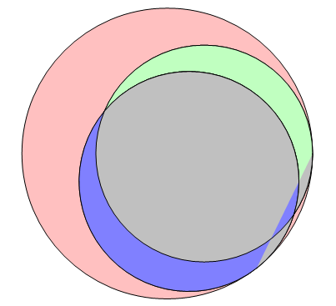
Breakdown of Consensus New Sequence IDs
187 Sequences matched to SNV or NOVEL Database at Consensus=3
  117 SNV; 70 Novel
Allowing for L/I substitution:
  104 are in NCBInr_Human
  60 are in Uniprot_Human
  103 are in Uniprot_Mammals
67
18
Extra Sequences
Found in NCBInr_Human
85
Found in Uniprot_Mammals
17

Slide 39
Examples of Consensus Novel IDs
GVSSAEGAAKEEPK – Identified by five participants
  KVSSAEGAAKEEPK is human sequence
  In each case the participant identified this peptide without TMT6
  modification of N-terminus
  Carbamidomethyl-VSSAEGAAK(TMT6)EEPK(TMT6) matches expected sequence
ESNPCPVITVEHFK – Identified by five participants
  Bears no similarity to any human sequence in database (would require 6aa
  substitutions)
  EPSPCPVITVEHFK is found in Hamster AP2-associated protein kinase 1

Slide 40
Preliminary Conclusions
Confident interpretations were reported for a surprisingly high percentage (82%) of spectra acquired.
Much higher agreement (and better reliability?) for SNV identifications compared to novel sequence IDs
  Consensus among results from same participant/lab clearly inflated consensus for novel sequence identification.
  Evidence for high FDR among extra sequence identifications for some participants (decoy database matches concentrated among extra identifications)
Many SNV and some novel sequence IDs are found in other reference databases.

Slide 41
Challenges of Reporting Requirements
How difficult was it to filter at 1% FDR
at the peptide-sequence level?
Biological significance was identifying reliable new sequences
  Some search engines do not make it easy to report peptide-level reliability measures
Comparing results from different database searches proved difficult for several participants
  There were errors in annotating whether a particular identification was an extra ID
  Extra IDs could be recognized by differently formatted accession names
      Novel: cuff_
      SNV: _SNV1

Slide 42
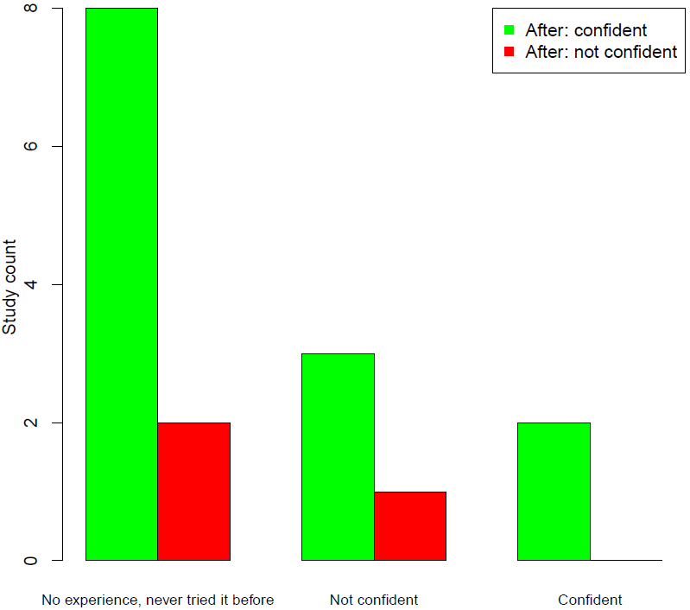
Increased Confidence After Participating in the Study
Before the study

Slide 43
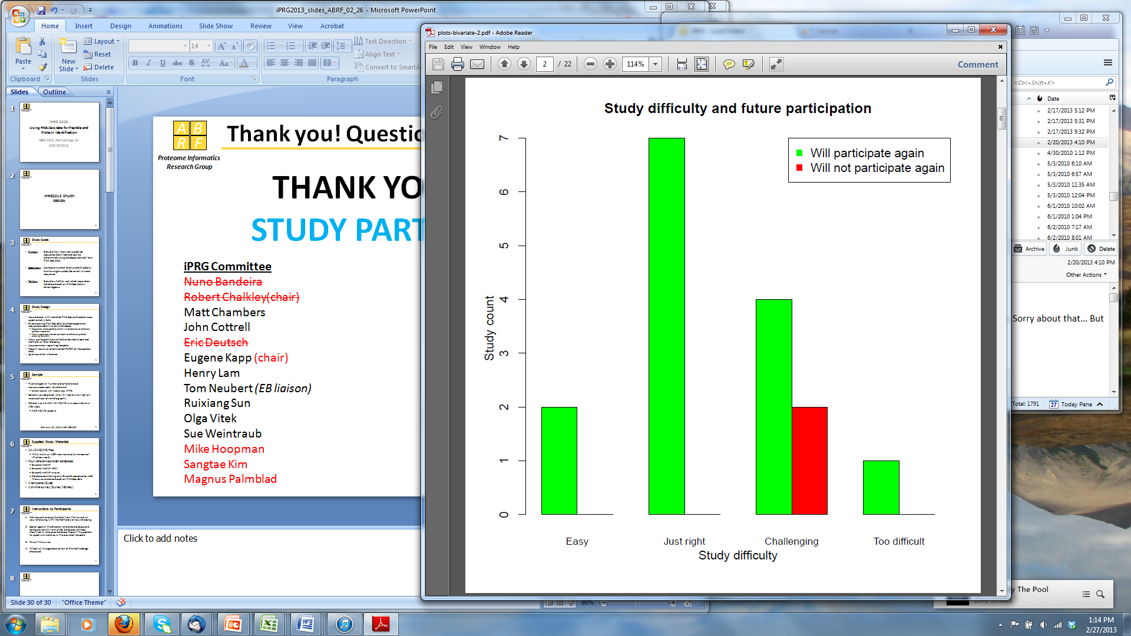
Difficulty and Future Participation

Slide 44
Future Plans
More formally compare different database construction approaches
Investigate effect of RNA-Seq derived smaller databases
Investigate why Novel matches seemed much less reliable than SNV
Search rest of Snyderome dataset
  Does using more RNA-Seq data provide a better proteomic database?
  Did all other time-points provide a similar number of SNV and novel matches?
Write manuscript

Slide 45
This study was brought to you by...
iPRG Committee
Nuno Bandeira
Robert Chalkley (chair)
Matt Chambers
John Cottrell
Eric Deutsch
Eugene Kapp
Henry Lam
Tom Neubert (EB liaison)
Ruixiang Sun
Olga Vitek
Susan Weintraub
Anonymizer:
Jeremy Carver, UCSD

Slide 46
The 2014 Team
iPRG Committee
Nuno Bandeira
Robert Chalkley(chair)
Matt Chambers
John Cottrell
Eric Deutsch
Eugene Kapp (chair)
Henry Lam
Tom Neubert (EB liaison)
Ruixiang Sun
Olga Vitek
Sue Weintraub
Mike Hoopman
Sangtae Kim
Magnus Palmblad

Slide 47
Thanks! Questions?
“The whole is more than the sum of its parts.”
Aristotle, Metaphysica
These studies do not work without participants.
Thank you to all those who made this study informative!

